Slide 1
Luke 6:1-11
(English Standard Version)

Slide 2
6 On a Sabbath, while he was going through the grainfields, his disciples plucked and ate some heads of grain, rubbing them in their hands. ² But some of the Pharisees said, “Why are you doing what is not lawful to do on the Sabbath?” ³ And Jesus answered them, “Have you not read what David did when he was hungry, he and those who were with him: ⁴ how he entered the house of God and took and ate the bread of the Presence, which is not lawful for any but the priests to eat, and also gave it to those with him?” ⁵ And he said to them, “The Son of Man is lord of the Sabbath.”

Slide 3
⁶ On another Sabbath, he entered the synagogue and was teaching, and a man was there whose right hand was withered. ⁷ And the scribes and the Pharisees watched him, to see whether he would heal on the Sabbath, so that they might find a reason to accuse him. ⁸ But he knew their thoughts, and he said to the man with the withered hand, “Come and stand here.” And he rose and stood there. ⁹ And Jesus said to them, “I ask you, is it lawful on the Sabbath to do good or to do harm, to save life or to destroy it?” ¹⁰ And after looking around at them all he said to him, “Stretch out your hand.” And he did so, and his hand was restored. ¹¹ But they were filled with fury and discussed with one another what they might do to Jesus.

Slide 4
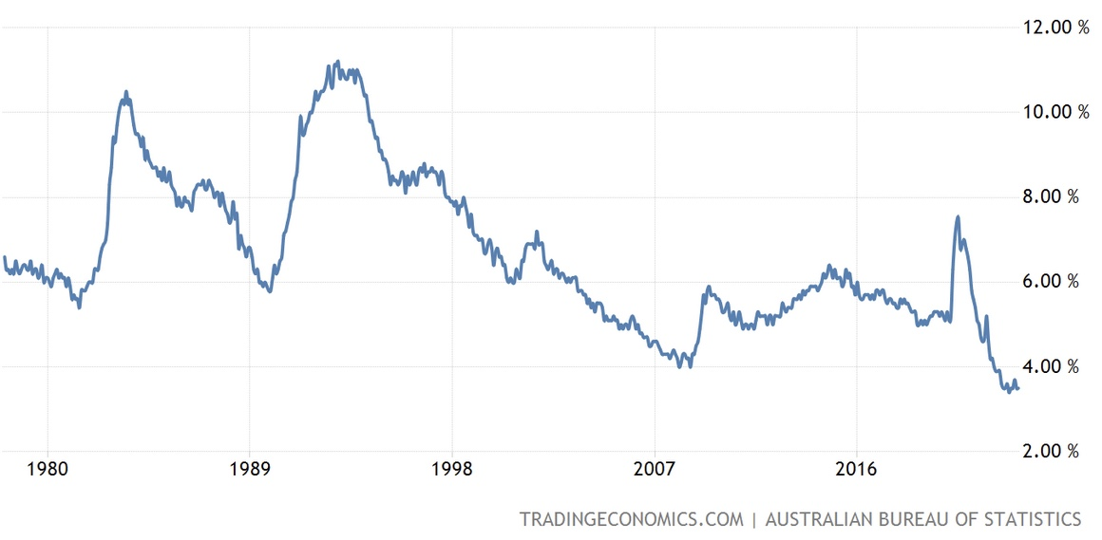
Australian Unemployment Rate
2019 Working hours of Males
45-59 hours/week – 19.4%
>60 hours/week – 8.9%
Source: Australian Bureau of Statistics

Slide 5
“How Ya Goin’??? Busy???”..........
The Sabbath –– Resting from Work
God worked on creation for 6 days. On the 7th, He rested, and made it Holy
Reminds us of:
1. The creative work of God – God rested on the 7th Day. Remember Creation.
Keep that day holy for God
2. The saving hand of God – Rescued from slavery – reminder we are not slaves to work
A sign of the Old Covenant – command to be obeyed – Do not profane the Sabbath
Not working every day of the week, is a gift from God.
Driven to over-work – Greed?; Pride?; Expectations of others/self?
God’s expectation is all that matters:
  A day of rest;
  A day, Holy to the Lord;
  A day for worship;
  A day to enjoy fellowship
Colossians 2:(ESV)¹⁶ Therefore let no one pass judgment on you in questions of food and drink, or with regard to a festival or a new moon or a Sabbath. ¹⁷ These are a shadow of the things to come, but the substance belongs to Christ.
Man-made rules around the Sabbath used to oppress and judge others;
Preparing a snack on the Sabbath did not profane it.
“The Son of Man is lord of the Sabbath.”
Jesus re-interprets the Sabbath as it was intended

Slide 6
“How Ya Goin’??? Busy???”..........
The Sabbath –– Resting from Work
Not working every day of the week, is a gift from God.
Driven to over-work – Greed?; Pride?; Expectations of others/self?
God’s expectation is all that matters:
  A day of rest;
  A day, Holy to the Lord;
  A day for worship;
  A day to enjoy fellowship
Colossians 2:(ESV)¹⁶ Therefore let no one pass judgment on you in questions of food and drink, or with regard to a festival or a new moon or a Sabbath. ¹⁷ These are a shadow of the things to come, but the substance belongs to Christ.
“The Son of Man is lord of the Sabbath.”
Jesus re-interprets the Sabbath as it was intended. Not a day to be profaned by profiteering,
But a day to Worship; Enjoy; Do good; Enjoy life.
Hebrews 4:(ESV)⁹ So then, there remains a Sabbath rest for the people of God, ¹⁰ for whoever has entered God’s rest has also rested from his works as God did from his. ¹¹ Let us therefore strive to enter that rest, so that no one may fall by the same sort of disobedience.
Jesus did the work of Saving on the cross – In Christ we rest from dead religious works. Saved by the blood of Jesus, repentance and believing in Him.

Slide 7
“How Ya Goin’??? Busy???”..........
The Sabbath –– Resting from Work
God’s expectation is all that matters:
  A day of rest;
  A day, Holy to the Lord;
  A day for worship;
  A day to enjoy fellowship
“The Son of Man is lord of the Sabbath.”
Jesus re-interprets the Sabbath as it was intended. Not a day to be profaned by profiteering,
But a day to Worship; Enjoy; Do good; Enjoy life.
Jesus did the work of Saving on the cross – In Christ we rest from dead religious works. Saved by the blood of Jesus, repentance and believing in Him.
If the Sabbath Law has been fulfilled in the age of Grace we now live, What now?
Keep the Sabbath holy. Do not profane it;
Rest remains a gift from God;
Do good;
Don’t be legalistic
Psalm 127:2 (ESV)
² It is in vain that you rise up early
and go late to rest,
eating the bread of anxious toil;
for he gives to his beloved sleep.
God gives rest.
It’s our vanity that keeps us being too busy.
How ya goin’? Filled with vanity?
It is empty/worthless to work and work and not rest

